Slide 1
Java SE 8 Book Presentation
Chapter 4 – Basic Java Elements

Slide 2
4.1 Convention – 4.1.2 Conventions in Java
Here is some of the most important conventions in Java:
I) Cases
Class names ALWAYS start with an UPPERCASE letter, e.g: “ReadOnlyArrayList” is valid but “Readonlyarraylist” is not
Package names are generally in LOWERCASE, e.g: “datastructure” is valid but “DataStructure” is not
Variable name starts with a LOWERCASE, and could include underscore (this is not recommended), e.g: ”current_account” is good enough but not perfect while “currentAccount” is perfect
II) Naming
Variable names should be meaningful. Some variable names such as “foo”, “bar”, “fubar” shouldn’t be presented in some enterprise-specialized programs or professional-programs (Although this is usable for code illustration).
The variable name also suggest the type of that variable (e.g: accountID = int).
Variable declared => cant change the type of variable (Java only) => indication of meaningful naming
III) Package name
Package name is always unique
Format: Reversed domain name combined with division/department/application name, e.g: If you are working in FPT’s Automation Division and you are developing some AI programs => your package name could be something like:
“com.fpt.autodivi.aiprog” or if you are also developing AI programs but from customer services => “com.fpt.csrv.aiprog”
=> this convention makes Java package name unique as the domain name of the organization is already unique

Slide 3
4.2 Java Identifiers and reserved words - 4.2.1 Keywords, literals, Reserved Words and Identifiers
There are certain words that we cannot use for other purposes => called “Keyword”, e.g: “class” is a keyword and when we write it, JVM automatically understands that the devs are trying to define a “class”. Hence, as soon as JVM see these keywords, it automatically executes predefined actions and cannot be stopped.
Moreover, Java also restricts some special words such as “goto” (Although it is not relevant to JVM the reason behind it is complicated and should not be discussed here)
“true”, “false” and “null” is called “literals” since JVM interprets these words directly with their meaning (not only these words are literals, numerical values are also literals since JVM also interprets it directly with their meaning).
These keywords, prohibited words and literals word sets are called “reserved words”.
If you are trying to capture a details of a car by using a class => we could call it class “Car” => “Car” is called ”identifier”. Each identifier is independent from programs => “Car” in class defining Java program could be the name of the class while the ”Car” in another program could be the name of a variable
Identifier has unlimited length (both digits and numbers) but the first character must be A LETTER. Identifier spelling must be different from Java reserved words

Slide 4
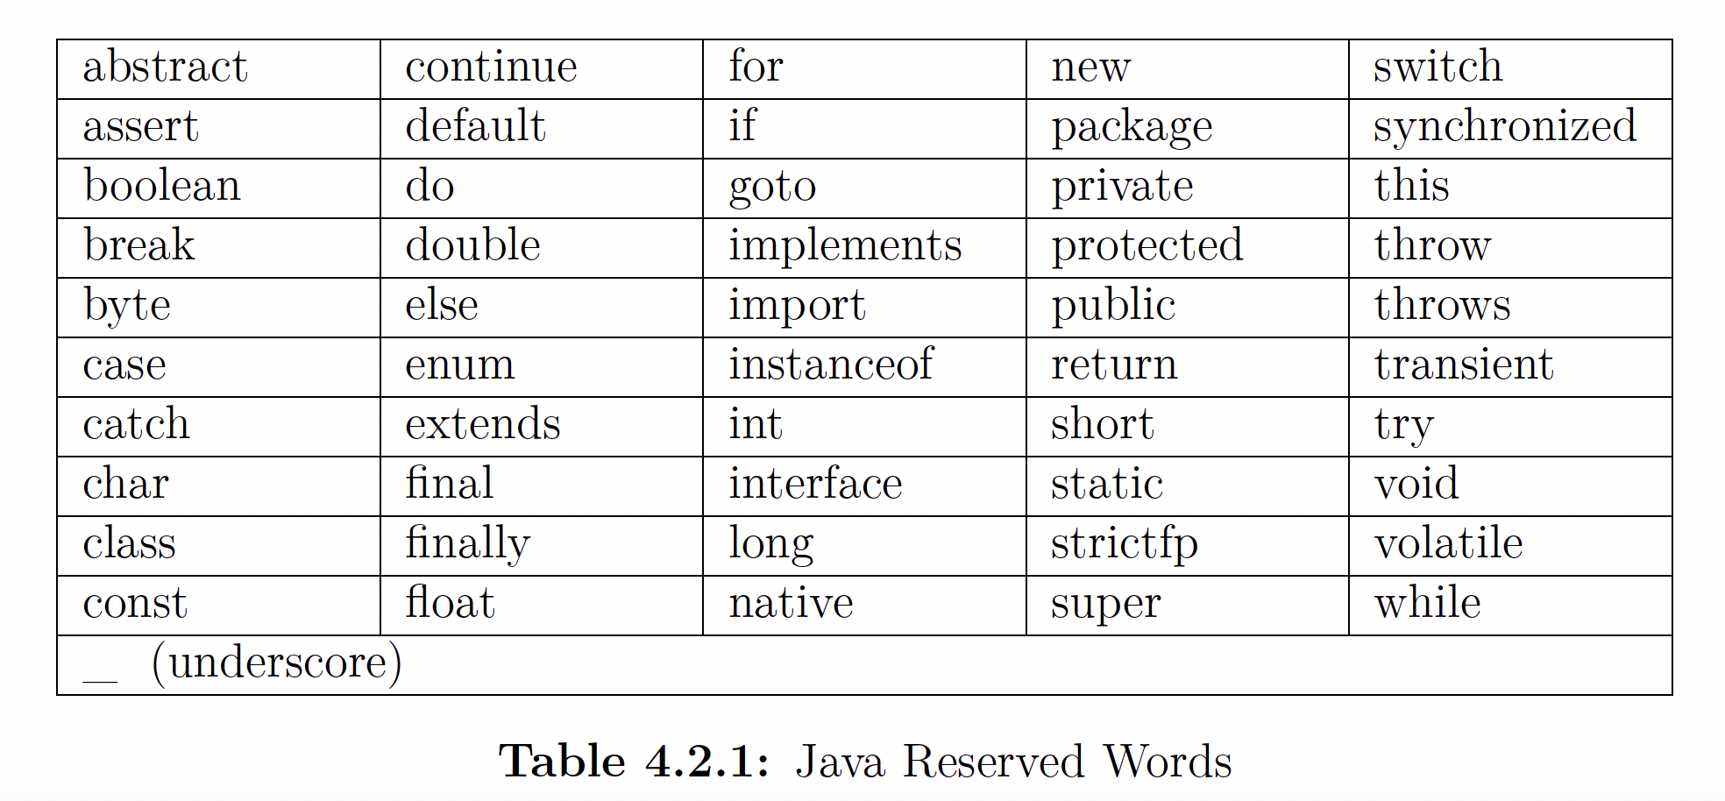
4.2 Java Identifiers and reversed words - 4.2.1 Keywords, literals, Reserved Words and Identifiers

Slide 5
4.2 Java Identifiers and reversed words - 4.2.1 Keywords, literals, Reserved Words and Identifiers
There are certain words that we cannot use for other purposes => called “Keyword”, e.g: “class” is a keyword and when we write it, JVM automatically understands that the devs are trying to define a “class”. Hence, as soon as JVM see these keywords, it automatically executes predefined actions and cannot be stopped.
Moreover, Java also restricts some special words such as “goto” (Although it is not relevant to JVM the reason behind it is complicated and should not be discussed here)
“true”, “false” and “null” is called “literals” since JVM interprets these words directly with their meaning (not only these words are literals, numerical values are also literals since JVM also interprets it directly with their meaning).
These keywords, prohibited words and literals word sets are called “reserved words”.
If you are trying to capture a details of a car by using a class => we could call it class “Car” => “Car” is called ”identifier”. Each identifier is independent from programs => “Car” in class defining Java program could be the name of the class while the ”Car” in another program could be the name of a variable
Identifier has unlimited length (both digits and numbers) but the first character must be A LETTER. Identifier spelling must be different from Java reserved words (review through invalid identifier in code)
A special case is “var” where ”var” is not a keyword. If we type in “ var var = “hello” “, JVM will automatically recognize ”var” and replace “var” with String (note: the first “var”, not the second “var”)
There are also 2 characters “$” and “_” that are included within Java (Historical reason, no need to mention about it here). Also, “_” itself is not a valid Java Identifier, a Java identifier

Slide 6
4.2 Java Identifiers and reversed words - 4.2.2 Summary of important Java Keywords
REVIEW THROUGH CODE

Slide 7
4.3 Create and import packages – 4.3.1 The package statement
Every Java source file is contained within a package. The name of the package is specified using the package statement contained within the source file. There can be only AT MOST 1 package statement residing within the source file and if present, it must be in the beginning of the source file (excluding the comment)
If the source file does not reside in any package, the source file will be belonged to a special package called Default Package. Any Java file that doesn’t reside in any package will be belonged to the default package
- Some important points about the default package:
Default package has NO NAME
Default package is a special package and “default” is not the name of the package (We can’t even specify a package name “default” since “default” is a keywords in Java.
Since default package is a special package, any classes reside on any source files that are contained within the default package won’t be able to import from other source files in other packages => this is why default package is not recommended
- Package name could be anything but it is recommended to use the convention that we have mentioned earlier
(Review through code for illustration)

Slide 8
4.3 Create and import packages – 4.3.3 The Import Statement
If all of your classes reside in a package, then you just need to use their simple class name in another class (code illustration) => called “Fully Qualified Class Name” – FQCN
- If there are 2 classes and one of which resides in another package => You can’t use their simple class name directly (JVM will complain since it will assume that the class that we are referring to belongs to the same package)
e.g: We have 2 classes “Test” and “Test2”
- “Test” belongs to package “Directory1”
- ”Test2” belongs to package “Directory2”
If we try to use Test in “Directory2” => JVM will complain since it will automatically recognize “Test” class as a class that resides within ”Directory2” => To use it, we have to use Fully Qualified Class Name, in this situation, is ”Directory1.Test”
However, this leads to an issue where there are too many FQCNs in a source file if we are trying to use the same class in another package => The “import” statement comes in => We only need a line of code “import Directory1.Test; “
If you need to use multiple classes from a package, you could either use “single import” or type in “import package.*; “ => When this line of code is invoked, JVM will automatically find all classes available in that package (However, this is usually not recommended since the class resides in that package could also use other classes from other packages => import all of them could be hard to figure out which class is referring to”
The word “import” here doesn’t mean that anything is imported into your code. It is just a ”hint” for the compiler to look up a class from another package. If JVM can’t solve the simple class name, it will search for the import statement, and if there are no import statement => error

Slide 9
4.3 Create and import packages – 4.3.3 The Import Statement
Some important points about the import statement:
+) We can either use “single import” or ”import all classes using *”
+) Either import statement or FQCN is allowed
+) Redundant or unused import statement is allowed. The number of classes imported is unlimited
+) A special package called “java.lang” is already imported into your code => No need to import it again using import statement or FQCNs. However, re-import it again using either way is still allowed since Java allows redundant import statement
What we can’t do:
+) In Java there is no definition called “subpackage”, e.g: parent directory and child directory, if the import statement specifies the parent directory => import only classes from parent directory not from child directory (to import from child directory, another import statement must be used)
+) We can’t import a package that doesn’t exist (e.g: import xyz.*; while xyz package doesn’t exist).
+) As I mentioned before, any classes residing in “default package” are not importable
+) If we try to use 2 classes with the same name but reside in different packages => We can’t use import statement for both classes since it will cause confusion for JVM for which class we are using right now. Instead, we have to use 1 import statement for a class and the FQCN for another class

Slide 10
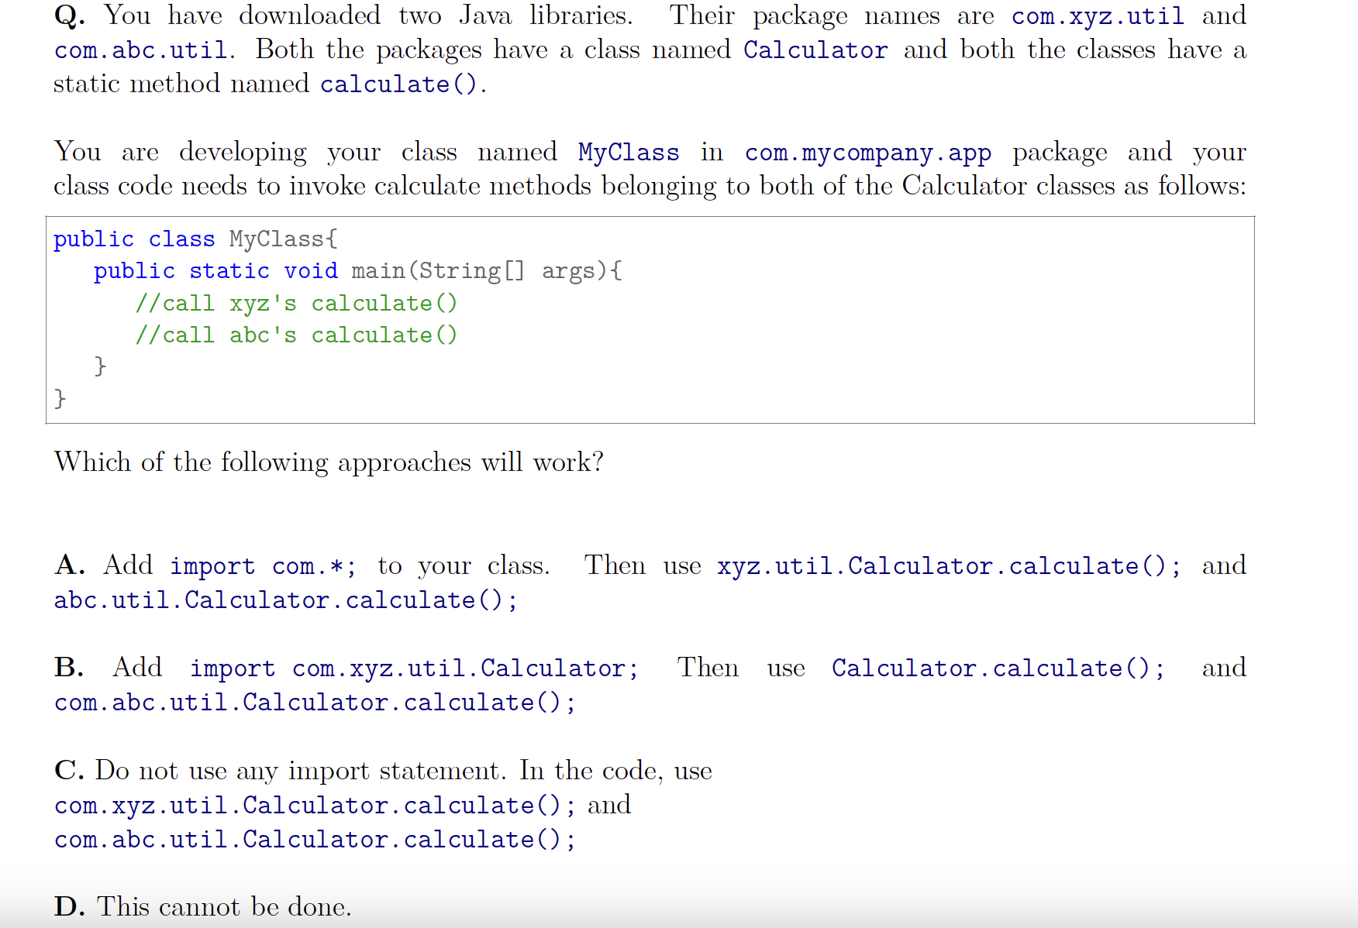
4.3 Create and import packages – 4.3.3 The Import Statement

Slide 11
4.4 Structure of a Java class – 4.4.1 Class disambiguated
The word class may have many meanings: The OOP terminology, the source code, and the “.class” file.
E.g: Capture the detail of ”student” as a ”class”, and then write the source code for ”class” Student in “Student.java”, and then compiling the “.java” file using javac command and produce a “.class” file

Slide 12
4.4 Structure of a Java class – 4.4.2 Structure of a Java Class
Zero or more package statement
Zero or more import statement
Zero or more type definition (could be class, enum or interface)
(We could also have more reference type – class definition within a single source file too)

Slide 13
4.4 Structure of a Java class – 4.4.3 Members of a class
The code we just illustrated resides within a package called “com.fpt” => the first line of the source file must be the package statement
The import statement indicates that we are using the Date class from the package “java.util”
To count the number of student instances, we have to use an “Instance field” – which belongs to the class itself and separate from the instances
The studentID on the other hand, is unique to each of the instances => it must be an “Instance variable” - that belongs to each of the instances and is separate from each an instance
NEW DEFINITION – “Static Initializer”: This initializer is initialized only once when the class is initialized
NEW DEFINITION – “Instance Initializer”: This initializer is initialized before a new instance of a class is created

Slide 14
4.4 Structure of a Java class – 4.4.3 Members of a class
- JavaDoc Comment: There is a format of comment, where we can write a description for a methods, constructors, and fields in a class. If you write a comment in this format, we could produce a HTML documentation using JavaDoc tool, and this format is called “JavaDoc Comment”
- JavaDoc tool is bundled within JDK, it extracts all information contained within the JavaDoc format. Fact: All Java APIs classes information are contained within this format => this produces the HTML pages for official Java API documentation

Slide 15
4.4 Structure of a Java class – 4.4.4 Relationship between Java source file name and class name
- There is only one rule about the relationship of the class name with the source file name: THE SOURCE FILE NAME MUST BE THE SAME WITH THE CLASS NAME THAT HAS A “PUBLIC MODIFIER”
There could be more than 1 type definition resides in a source file (but there should be only 1 type definition that has a ”public” modifier)
These rules are applied to Class, Interface, Enum
Nested type is a special case, where we could have multiple type definitions (with multiple modifiers) reside in another type definition (if this type definition is not nested anymore => called “top level” types. However, this case is too advanced and should not be discussed here
IMPORTANT: These rules are restricted by “Java Compiler” not “JVM”. Since the job of Java compiler is to translate these type definitions that reside in the source file into Java Bytecode (“.class” file) => JVM only understands these files (Since JVM only understands s Bytecode as their machine language) => JVM doesn’t understand the source file
Although there are no restrictions toward this, it is recommended to have a type definition (whether it is public or not) reside in their file (and it is also recommended that the name of the type should also be the same as the file name)
EXAM TIP: In Foundation test, some questions contain multiple public classes. But don’t jump immediately to the final conclusion that this code won’t work (Unless it is explicitly stated that these classes are in the same file) since Oracle wants us to assume that these public classes reside in different files.
IMPORTANT: Although it is recommended that we keep the source file in the same directory as the package statement resides in the source file. However, some IDEs (particularly inteliJ) enforce this rule and don’t allow us to put the source file in another directory that hasn’t been specified in the package statement. However, Java ”language” doesn’t require this rule and we can still compile the code smoothly using the command line.

Slide 16
4.5 – Advanced Java Compilation and Execution – 4.5.1 Compilation and Execution Involving Package
- In chapter 3, we studied how to compile and execute a Java program using “javac” command from command line. However, that was just a simple compilation/execution task irrelevant to the package statement. In this section, we will study how to compile/execute a Java program with package statement included
– (Code illustration)
The reason why a Java program with a package statement can’t be compiled and run in traditional ways is that JVM is “expected the CLASS file resides in the directory STRUCTURE that matches the package statement in the source file” => Running a Java program in a directory that is different from the package statement resides in that source file is IMPOSSIBLE (This is one of the reason why inteliJ has created the same version of “src” directory called “out” and this directory contains the “.class” file)
Therefore, an option for “javac” command for this situation is the “-d” option. This option tells JVM to create a “directory structure” similar to the package statement and then put the “.class” file into that directory. In our example, the package specified is “accounting” => a folder name “accounting” will be created from the “-d” option and the “.class” file will reside inside that folder. The “.” after the “-d” option is to indicate that the current directory will be used to print out the final result. We can replace this “.” with other directories that we want JVM to create and print out the final result.
(NOTE: Print out result here doesn’t mean that any new file in that current directory specified is created. It is just the directory that the command line must go to so that we can use FQCN to print the final result from the “.class” file)
When the compilation is completed, we have to tell JVM where the class file resides by using the option “-classpath” or its shorter version “-cp”. This option allows us to have multiple locations for multiple classes (each location is separated by the semi-colon “;”). For instance, if you have a class on C:\system32 and another class in C:\ => the command should be like this :
“java –classpass C:\System32;C:\ accounting.Account” (BE CAREFUL: this 2 folders reside in the same directory)
(NOTE: The “java” command – without the classpath option will automatically scan the current directory and the packages for the class file => there is no need to use the ”-classpath” option)

Slide 17
4.5 – Advanced Java Compilation and Execution – 4.5.1 Compilation and Execution Involving Package
- We have 2 Java source files (illustrate the code) and if we compile the file ”MultipleClassExample.java” => we will get an error since this class depends on another class, which resides in a file called “StudentClassPathExample.java” and this class hasn’t been initialized yet. Therefore, we must have to compile “StudentClassPathExample.java” first and then compile ”MultipleClassExample.java” => The code will run flawlessly
- But the problem is that a large Java application is composed of many different Java classes and their dependence is complicated => It is impractical to trace the sequence of compilation => A way to solve this is to let the Compiler determine the dependence between classes. There are 2 commands that we can use to apply this solution
– The first command is: “javac –d . A.java B.java”. This command allows us to compile multi-selected Java source file for compilation. But still, it is still impractical since there might be more than a thousand Java source files
- The second command is: “javac –d . *.java”. This command is almost the same as ”import com.<…>.*” , which indicates “include all” => this comment will compile all Java source files reside in a directory

Slide 18
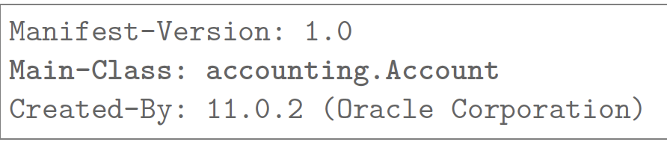
4.5 – Advanced Java Compilation and Execution – 4.5.2 Packaging classes into Jar
- An application may be composed of hundreds or thousands of classes. If the client wants to use the application, they will have to download each “.class” file individually. We can zip the file into “.zip” archive, but then the client still has to unzip all of the class files and then execute it. To prevent this from happening, Java has developed its archive type known as “Java Archive” which is a version “.zip” archive but with an extension of “.jar”
(Code Illustration)
- When we are looking inside a ”Jar” file, we will see that the directory structure of a class is maintained. We can see the content of a jar file by open it using WinRar or 7zip
Java allows us to store the information of the Jar file within the Jar file itself, this file is called ”MANIFEST.MF” and it is stored within a folder named “META-INF” of the Jar file. This manifest file has many usages, for example, we can point out the starting position of an application which will allow us to run the Jar file directly either from command line or just click on it. Therefore, we won’t have to specify the FQCN that contains the main method anymore.
This picture below shows the typical content of a normal manifest file contained in the Jar file

Slide 19
4.5 – Advanced Java Compilation and Execution – 4.5.3 Compilation error VS exception at run time
A compilation error will happen if the developer tries to violate the syntax rules of the programming language (e.g: if a dev tries to put package statement at the end of the program => a compilation error will arise since this code is syntactically incorrect)
Moreover, a compilation error will happen if the logic of the code is also incorrect (e.g: “byte b = 200;” will result in a compilation error since the compiler still understands that a that value is too large for a byte, while “int I = 10/0” won’t result in any errors since the compiler can’t execute any codes)
On the other hand, JVM always protects its integrity and type safety. Unlike the compiler, JVM is capable of executing and understanding code flawlessly. Therefore, if JVM sees any codes that might damage its integrity or its type safety, it will automatically return an “exception” => any potential illegal activity that hasn’t been detected by compiler yet will be caught by JVM (e.g: divide a number by 0)

Slide 20
4.6 The Java.lang and other standard Java package
- One of the largest advantages of Java is the large ready-to-use Java APIs library

Slide 21
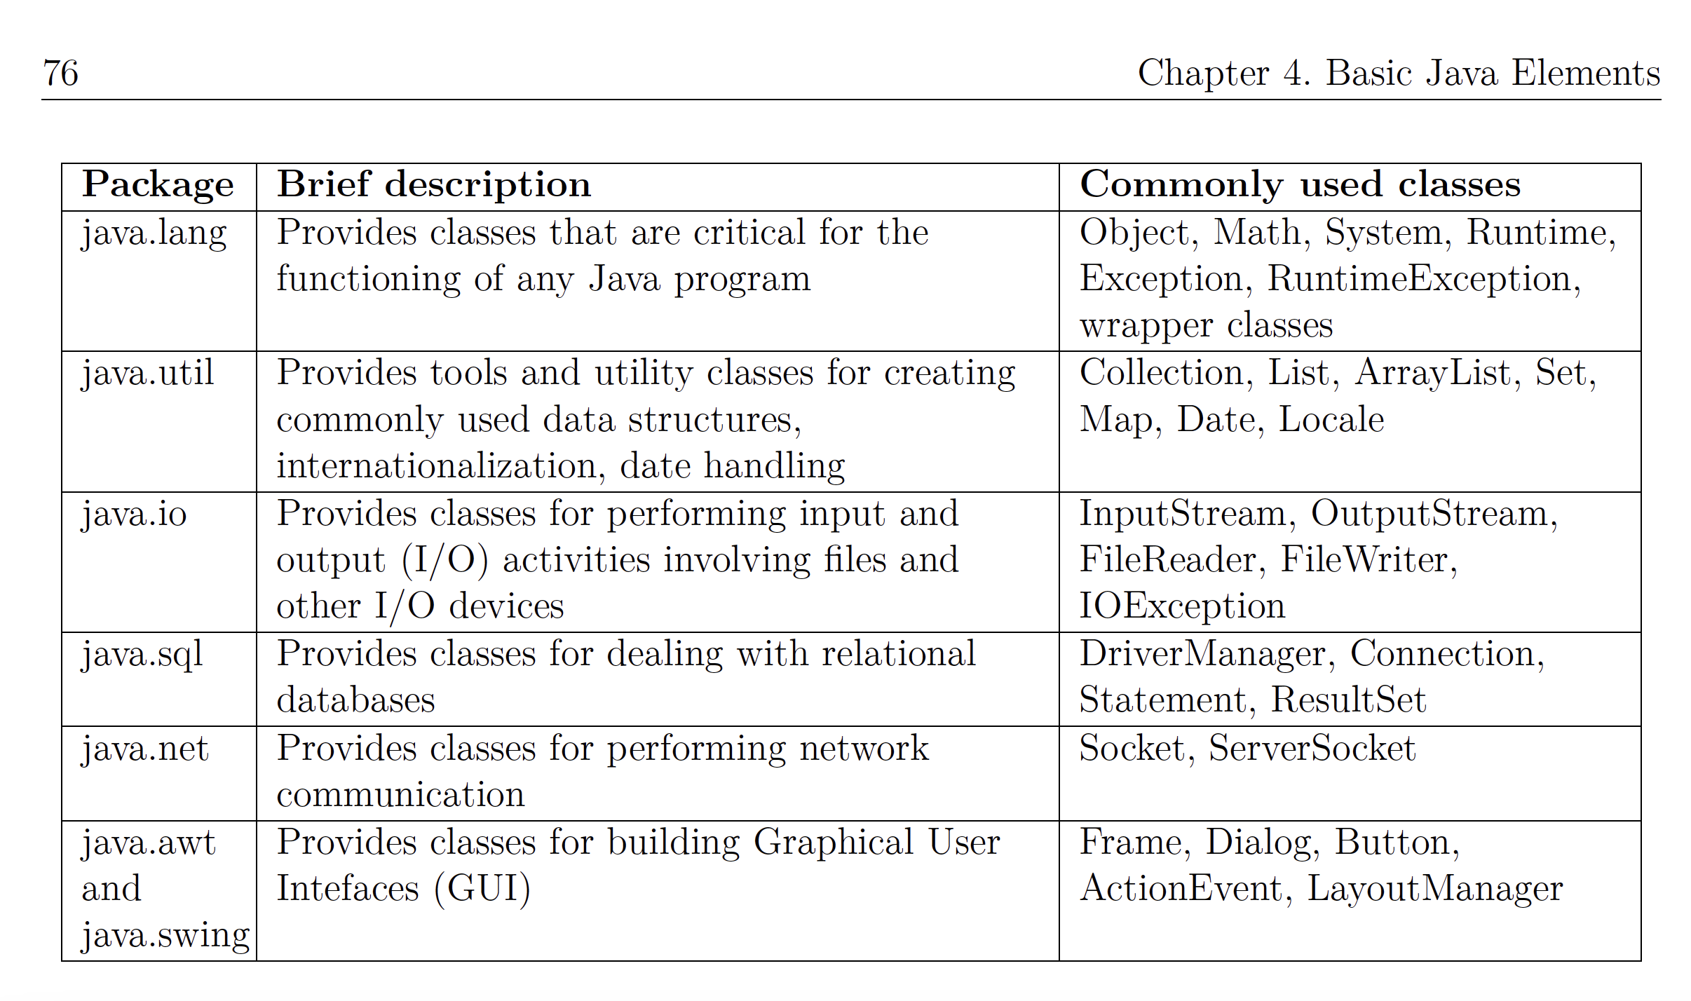
4.6 The Java.lang and other standard Java package
This picture shows some of the most important package that are commonly used in Java Development

Slide 22
4.6 The Java.lang and other standard Java package
One of the largest advantages of Java is the large ready-to-use Java APIs library
However, in the scope of this test, we only need to know about “java.lang” package
I) The “java.lang.Object” class
- If you create a class that doesn’t extend any other classes => This class is “implicitly” extending the “Object” class
- ”object” is a special class that doesn’t extend any more class => we can call it an “Ultimate parent” of all classes. It is the root of Java class hierarchy
=> This is why we tell everything in Java is an object (except primitive datatype). This is because primitive and reference datatype are completely different out of each other. Primitive datatype only represent “pure data” while reference datatype represent both “pure data” and “behavior” (e.g: Motorbike instance can represent “pure data” such as the ID of the engine or the behavior such as accelerating) => Both of them are treated differently
– However, ”java.lang” package also contain the OOP version of these primitive datatypes too (Boolean, Byte, Integer, Long,…) => called “warpper classes”
– In Java 1.5, a feature called “autoboxing” that allows the interaction between ”warpper classes” and primitive datatypes

Slide 23
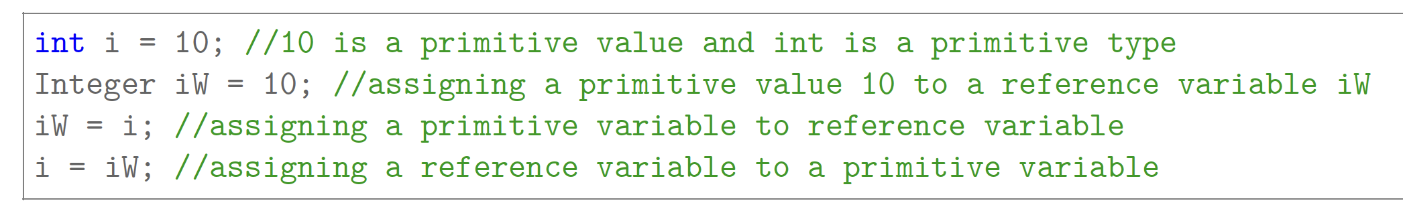
4.6 The Java.lang and other standard Java package

Slide 24
4.6 The Java.lang and other standard Java package
These statement are pretty special
+) Assigning reference variable to a primitive variable is NOT ALLOWED. However, “warpper class” is an exception due to the “autoboxing” feature of Java
+) When assigning a primitive variable to reference variable, the value of primitive variable will be automatically “wrapped up” into the corresponding class
+) When assign a reference variable to a primitive variable, the value of the reference variable will be automatically “unboxed” and the value will be assigned to the primitive variable
(In this test, we will assume ”warpper class” and primitive datatype is interchangeable” )
II) ”java.lang.System” class
- This is the class for printing output to the screen. This “java.lang.System” class has a variable named “out” and the type of this variable is “printStream”, which contains various print/println method
III) “java.lang.Math” class: This class is for mathematic function such as trigonometry, logarithms,etc…
IV) “java.util.Random” class: This class is for generating random number
V) Importing “java.lang” package: This package is so important that even if we do not explicitly import it using import statement or using FQCN, Java automatically import this package.

